Slide 1
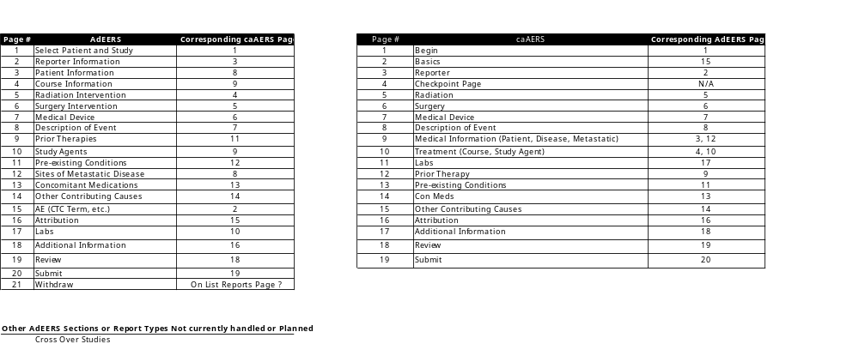
AdEERS - CaAERS Map
caAERS has a corresponding section for each and every AdEERS section

